Slide 1
Financing Development
Low income frustrates people's development, as they simply do not have the means to acquire the basic goods they need. Here comes the importance of Financing Development.
The size of primary income determines what food or other essential items any household can afford.
The best strategy for development (human) is to increase the primary income in a society by unleashing the creative energies of its people, its resources and its capacities, and by ensuring that these incomes benefit the majority of the population.
Governments offer supports through health, education or other services as they should.

Slide 2
Level and structure of government social expenditures and the design of the policy measures and programmes they support play an important role in development in a country.
Government must:
Allow markets to work properly-The small enterprises should not be stifled with excessive regulations. But regulations must be in place to ensure competition.
Correct for failures of the market by discouraging activities like pollution or traffic congestion, certain types of stock exchange speculation or the consumption of goods like cigarettes or drugs or petrol. Conversely, the state should subsidize activities, such as public transport, that it wishes to encourage.

Slide 3
Create physical infrastructure - such as roads, railways, harbours, electric power station and telecommunications. The state is often best suited to providing infrastructure itself, but where private enterprise can provide it efficiently, policies must promote private investment.
Support important public goods- including a legal framework, public parks and defence and national security.
Ensure that people are at the centre of development- investing in the formation of human capabilities, mobilizing and using people's productive and creative potential and making social security arrangements available to those who may not be able to help themselves especially for the unemployed, the elderly and disabled or otherwise incapacitated persons.

Slide 4
Public Spending on Development
How public spending on development can be designed and monitored are usually done through four ratios such as:
The public expenditure ratio- the percentage of national income that goes into public expenditure.
The social allocation ratio- the percentage of public expenditure earmarked for social service.
The social priority ratio- the percentage of social expenditure devoted to human priority concerns.
The human expenditure ratio- the percentage of national income devoted to human priority concern .

Slide 5
The human expenditure ratio is the product of three ratios:
E/Y = public expenditure as a proportion of national income
S/E = the proportion of public expenditure going to the social sector-the social allocation ratio
P/S = the proportion of expenditure in the social sectors going to human development priorities -the social priority ratio.
Put differently the human expenditure ratio
= E/Y × S/E × P/S

Slide 6
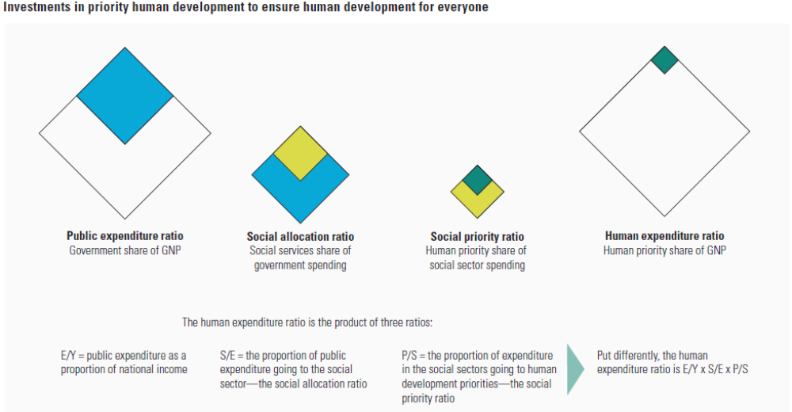

Slide 7
The human expenditure ratio is the product of the first three ratio. It is a powerful operational tool that allows policy-makers who want to restructure their budgets to see existing imbalance and the available options.
If public expenditure is already high (as in many developing countries), but the social allocation ratio is low (such as in Tanzania), the budget will need to be reassessed to see which areas of expenditure could be reduced. Military spending, debt servicing and loss-making public enterprise would all be likely targets.
If the first two ratios are high, but the ultimate human development impact, as reflected in human development indicators, is low (as in Pakistan), the social priority ratio must be increased.

Slide 8
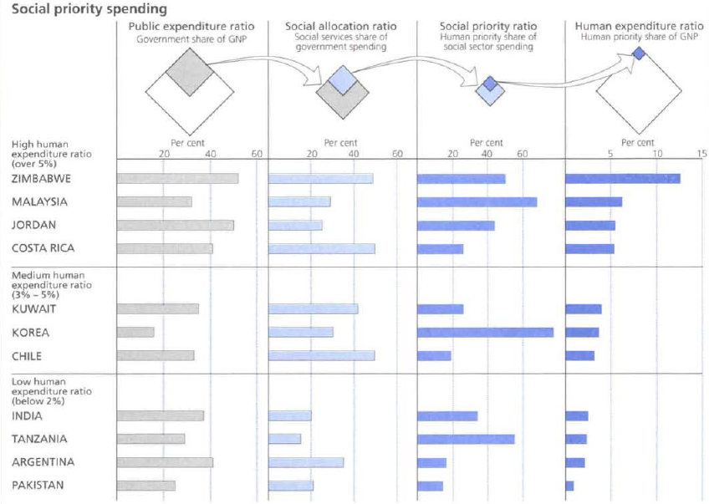

Slide 9
For the poorest countries, this is likely to involve seeking a better balance between expensive curative hospitals and preventive primary healthcare, between universities and primary schools and between focusing greater attention on the cities and on the rural areas, where most poor people live.
Pakistan and Indonesia have a low human expenditure ratio, despite reasonable overall levels of public expenditure.
The reason is that their social allocation and social priority ratios are low. The Republic of Korea on the other hand, directs a large share of its relatively small public budget towards social priorities and has as a result, a much better human expenditure ratio.

Slide 10
Even countries with a high human expenditure ratio (such as Jordan) rely on large public expenditure ratios, while others (including Malaysia and Morocco) have particularly high social priority ratios.
From several studies it is found that the human expenditure ratio may need to be around 5% if a country wishes to do well in human development.
This can be achieved in different ways both efficient and inefficient.
A preferred option is to keep the public expenditure ratio moderate (around 25%), allocate much of this to the social sectors (more than 40%) and focus on the social priority areas (giving them more than 50%).

Slide 11
An inefficient option is to withdraw a large proportion of national income into the public sector, to depress private investment and initiative, and to resource expansion that can ultimately finance development.
Budgetary interventions need not be extensive if GNP growth is rapid and equitable or if the private sector and non-governmental organizations are extremely active in social spending.
High government spending with low social priorities is the worst case. If 25% or more of national income is channeled through the government budget, and yet less than 1% of GNP goes into human priority concerns (as in Pakistan and Indonesia), this is the worst of all possible worlds. The public spending is huge yet the majority of the population does not benefit from public social expenditure.

Slide 12
Several developing countries have moved beyond basic priorities. Countries like Mauritius, Singapore, the Republic of Korea, and Chile may have only a moderate human expenditure ratio when the priorities considered are basic ones. But they already have achieved high levels of human development and can therefore shift their focus to supporting social services at a higher level.
The human expenditure ratio should increasingly become one of the principal guide to public spending policy. When resource are tight, greater attention must be paid to allocation priorities and efficiency in spending.

Slide 13
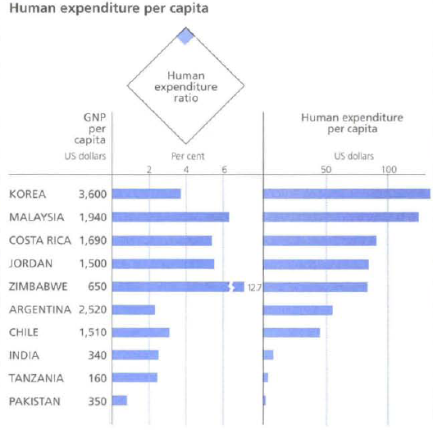

Slide 14
Thus we face some of the basic issues such as:
What are the aim of public spending? Who benefits from it? Does it encourage or discourage private initiative? Does it crowd out private investment?
Many developing countries spend one-quarter or more of the national income through the government budget, yet very little of this goes to human priority concerns- less than 3% of national income.
Taxation is the main source of finance for public expenditure. The possibilities for raising tax revenue obviously vary among countries, depending, among other things, on the structure of the economy, on the stage of development and on the country’s institutional capacity.

Slide 15
A government's expenditure can (and often does) exceed its revenues, but such "deficit financing" can lead to a very unstable economy.
Bolivia in the 1980s is an extreme example: its deficit rose to 28% of GNP leading to hyperinflation and a serious economic crisis. So, each country should aim at roughly balancing its budget.
Taxes in developing countries typically come from three major sources: direct tax (on personal income or on corporations), indirect tax (usually on sales) and taxes on foreign trade.
Other, less widespread forms of taxation, such as social security contributions, are significant for some countries in Latin America (representing about 27% of revenue in Uruguay). But they are not collected at all in many other parts of the world.

Slide 16
The "revenue ratio" for any country is the government's total revenue from all sources expressed as a percentage of GNP.
If a government wants to spend more money on human development (while still balancing its budget), it will have to raise its revenue ratio, or reallocate revenue from other parts of the budget to the social sector. The potential for doing either may vary greatly from one country to another.
Administration-The tax systems in most developing countries are complex and unstable. Much more revenue could be gained by simplifying the procedure, collecting all the information required and then enforcing collection. Reducing the number of exemptions, expanding the tax base and perhaps reducing tax rates would help rationalize existing systems and increase total revenues.

Slide 17
Tax handles-These refer to administratively simple ways of collecting taxes. The opportunities for taxation are often quite limited in economies that are largely agricultural- or where production is for subsistence, or takes place in small enterprises.
Income- A country's wealth and its efforts to raise taxes are not necessarily correlated. Colombia is much richer than India, for example, yet has much the same tax ratio.
While Bolivia and Zimbabwe have similar levels of GNP per head, their tax ratios are very different. This shows the untapped potential for raising public resources.

Slide 18
Economic growth- What does matter however, is whether the economy is expanding. Economic growth facilitates increasing revenue ratios as happened in the 1980 in Botswana, Burkina Faso, Colombia, Indonesia, the Republic of Korea, and Sierra Leone.
The social allocation ratio
Governments also differ greatly in how much of their spending goes to social areas like nutrition, health and education. The social allocation ratio varies greatly-from 13% in Indonesia to 50% in both Costa Rica and Chile.

Slide 19
For some countries, the social allocation ratio refers only to central government spending. Regional or local authorities also contribute to social sector spending and this can be a significant proportion for federally structured governments like India's, where 85% of expenditure on education and health comes from provincial or local government.
A high social allocation ratio does not guarantee a good human development performance, but it does make an important contribution. Some developing countries have high social allocation ratio and social priority ratio -and have also attained high levels of human development. Almost all start from large public expenditure ratios-one-third or more of GNP. But many of these countries could find ways to reduce the size of the public sectors and yet maintain, or even increase, their human development spending.

Slide 20
Increasing the social allocation ratio
Financing development usually involves switching resources from other areas of government expenditure.
Restructuring budgets may be difficult. Each government has existing commitment to fulfil and operates under political constraints. Still, it is easy to exaggerate these constraints and encourage passive attitudes toward highly undesirable spending patterns.
Development and economic growth need to be promoted together. Expenditure on economic item - including infrastructure such as roads and telecommunications is very important for overall development. So, increasing social expenditure should not mean diverting resource from the economic sector. There may be some potential for savings in this sector, but widespread economic cut-back could undermine the potential for growth.

Slide 21
Area that have a great potential for releasing funds for more productive uses are:
  Defence Expenditure
  External debt
  Internal debt
  Internal policing
  Public enterprise losses
Most external debt in developing countries is owed by the government, either because of the public sector undertook the initial loan or because it guaranteed private liabilities. The net negative resource transfers from high debt obligations and the collapse of voluntary lending have imposed a severe resource constraint on public expenditure-inhibiting policies for restructuring, investment and growth.

Slide 22
Countries acquire the internal debt in several ways, including national saving schemes and selling government bonds. Internal debt may seem of less concern than external debt since interest payments and amortization do not involve resources leaving the country. They are transfer payments from one group of citizens to another. But the problem of internal debt is still serious.
Internal policing, a great deal of security expenditure in many developing countries, is aimed at maintaining law and order, or policing the country's people. But quantifying this expenditure is not easy. Security spending takes diverse forms. And the budget for internal policing may be shown under various government departments.

Slide 23
The social priority ratio
The social priority ratio is the percentage of social expenditure directed at the priority areas. What is considered to be a priority will naturally change from one country to another, and change over time as human development proceeds.
Countries that have already achieved higher standards of literacy may well regard higher education as their next priority area. Where basic standards of health have been achieved, health minister will want to increase attention to more sophisticated kinds of curative care.

Slide 24
Universal human development could be accelerated if some multidimensional high impact interventions are pursued
  Providing school meals
  Redistributing assets (land reform, Subsidizing inputs for poor people)
  Prioritizing local actions (for limiting conflict, protect minority rights, improve service delivery) - Local approaches can contribute much to human development in the poorest areas
Differences in educational attainment prevent poor people from becoming part of the high-productivity growth process

Slide 25
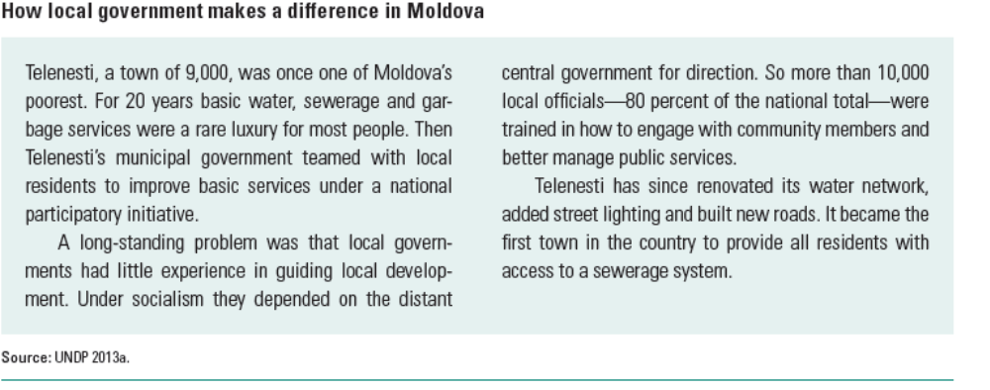
Enhancing opportunities for women
  Investing in girls and women brings multidimensional benefits— for example, if all girls in developing countries were to complete secondary education, the under-five mortality rate would be halved
Encouraging and supporting female entrepreneurs
  Mentoring, coaching and sponsoring can empower women in the workplace by using successful senior female managers as role models and as sponsors

Slide 26
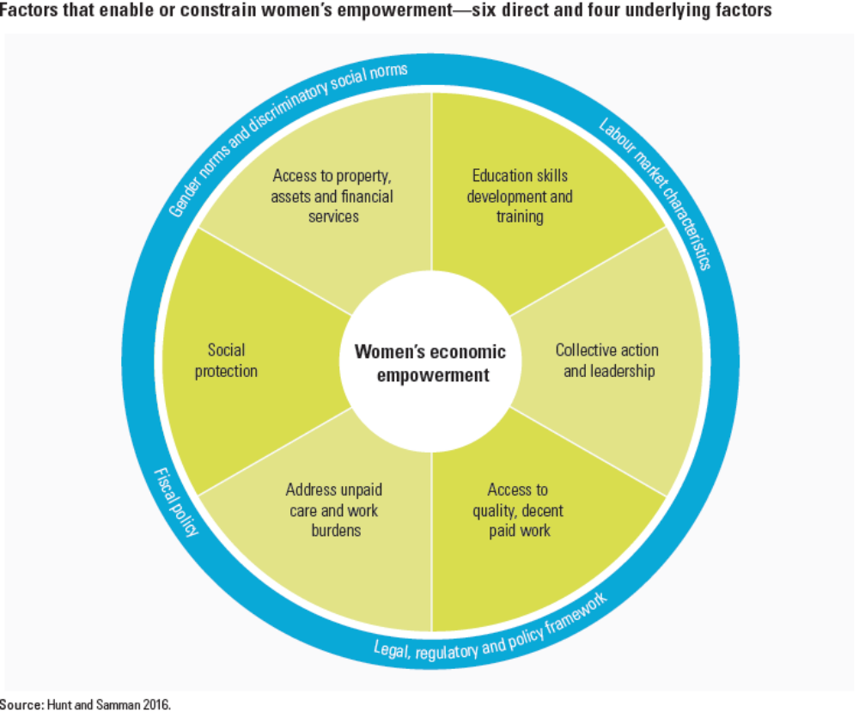

Slide 27
International aid
Aid programmes also offer great potential for restructuring-and an enormous pay-off.
Aid budget, like government expenditures, can be examined through four ratios:
The aid expenditure ratio- the percentage of a donor's GNP that it gives in aid.
The aid social-sector ratio- the percentage of each donor's aid that goes to the social sector.
The aid priority ratio- the percentage of social sector aid committed to human priority areas.
The aid human expenditure ratio- the product of the three foregoing ratios, and thus the percentage of a donor's GNP going to human priority areas in recipient countries.

Slide 28
Mobilizing Domestic Resources
Developing countries need to take the lead in mobilizing the financing necessary for their development.
Increasing domestic revenue mobilization remains a challenge for many governments, particularly in low-income countries.
Broadening the tax base, improving tax administration, and closing loopholes could make a significant difference in lower-income countries.
Capacity constraints often prevent developing countries from effectively and efficiently obtaining revenues from extractive industries.
Natural resource-rich developing countries could improve their capacity to negotiate fair contracts in extractive industries.

Slide 29
Considerable resources could be realized from public sector efficiency gains and reallocated towards development objectives.
Subsidy reform is one of the main areas in which public resources can be redirected to more effective uses.
Procurement in developing countries
Curbing Illicit Financial Flows
(Illicit financial flows (IFFs) are outward cross-border capital flows of illegal origin. IFFs encompass: (i) funds obtained through drug trafficking, smuggling, fraud and any other serious crime; (ii) the proceeds from corruption, bribery and embezzlement; and (iii) tax evasion.)

